Slide 1
Welcome!
Sherlin Whaley
Certified Data Scientist

Slide 2
Mission Statement/Goals
To provide schools and districts with an optimal view of their student’s data.
To objectively come to relevant and insightful conclusions based on the data.

Slide 3
Methods
Data Source: Kaggle.com
Data Content: Student Grades from the UK
Analysis Performed:
Linear Regressions 1 & 2
Random Forest
Step-wise Regression
Basic Anovas 1, 2 & 3

Slide 4
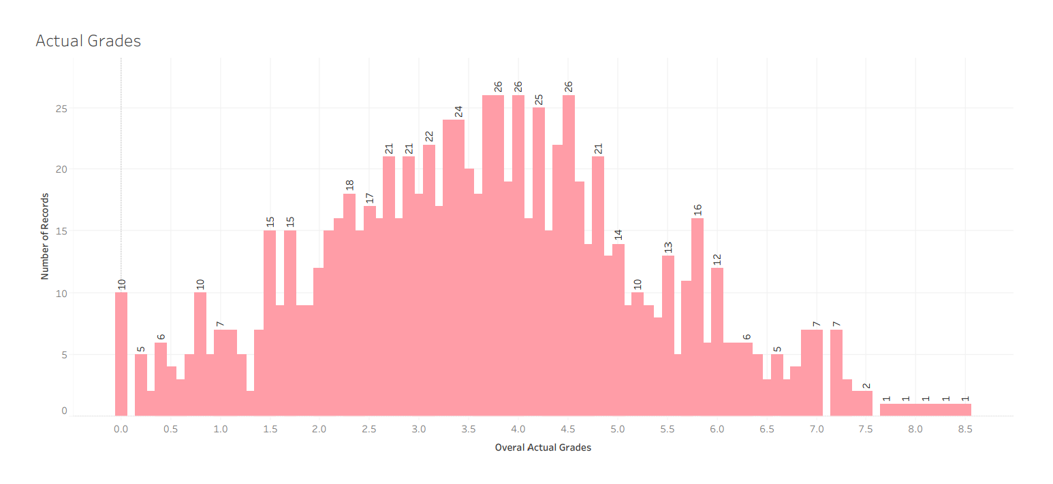
Overall Average of All Earned Grades

Slide 5
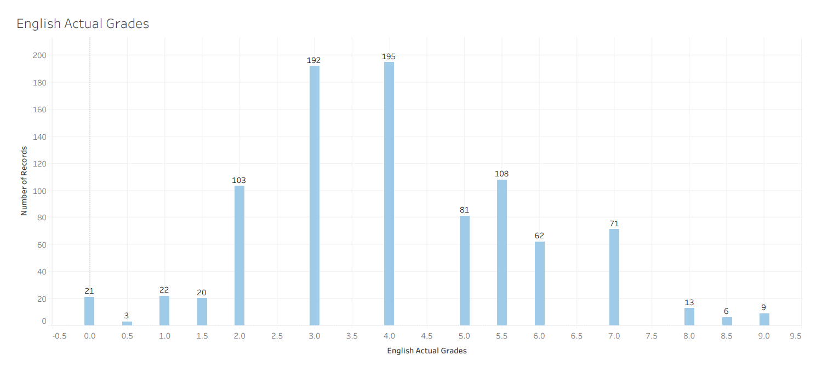
English Earned Grades

Slide 6
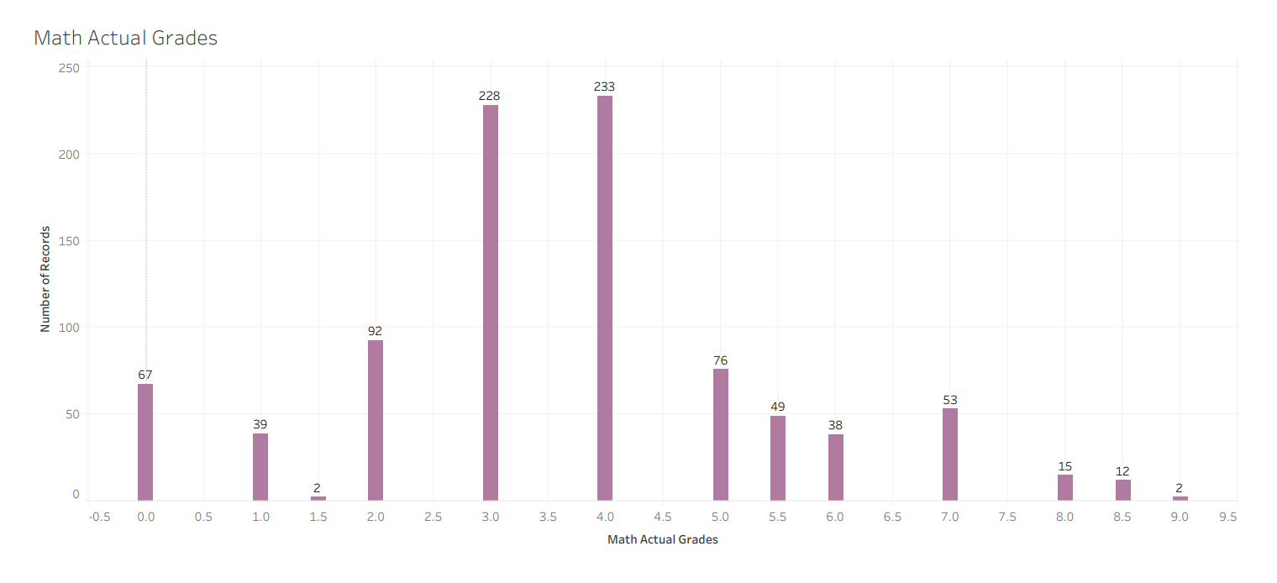
Math Earned Grades

Slide 7
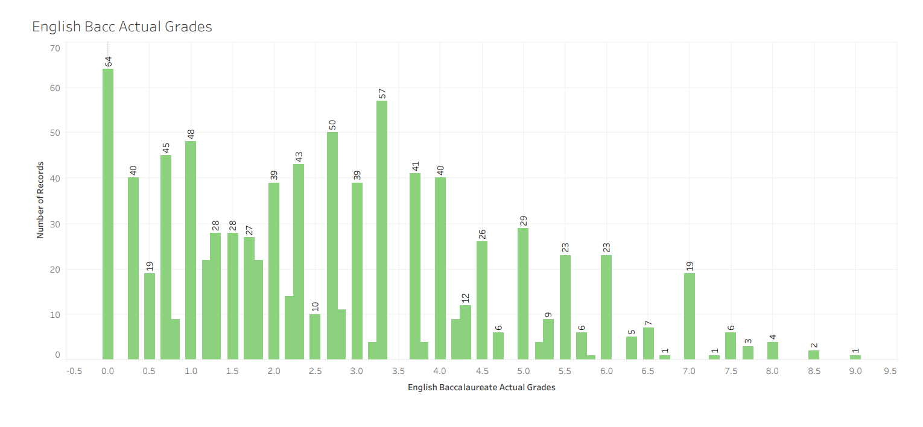
English Baccalaureate Earned Grades

Slide 8
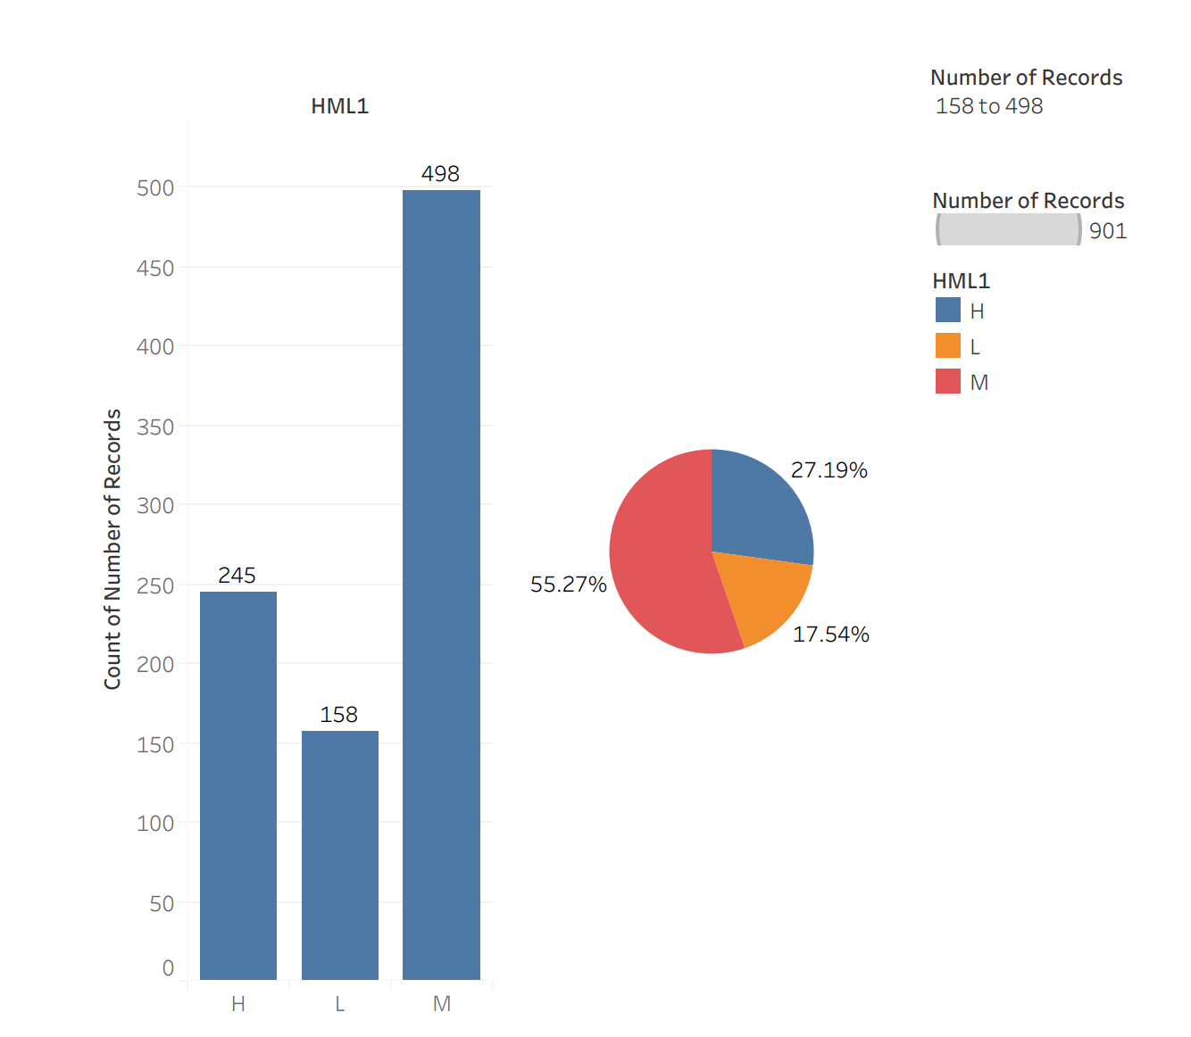
Students by Learner Level High – Medium - Low

Slide 9
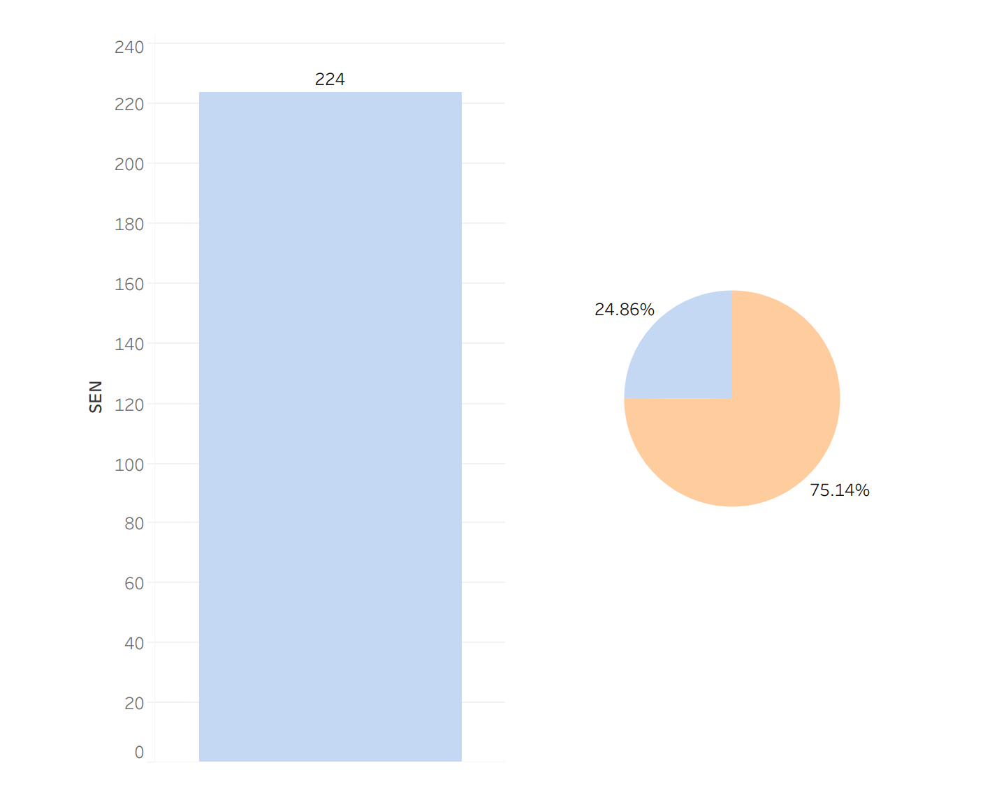
Students with Special Educational Needs (SEN)
SEN Students
Students without SENs

Slide 10
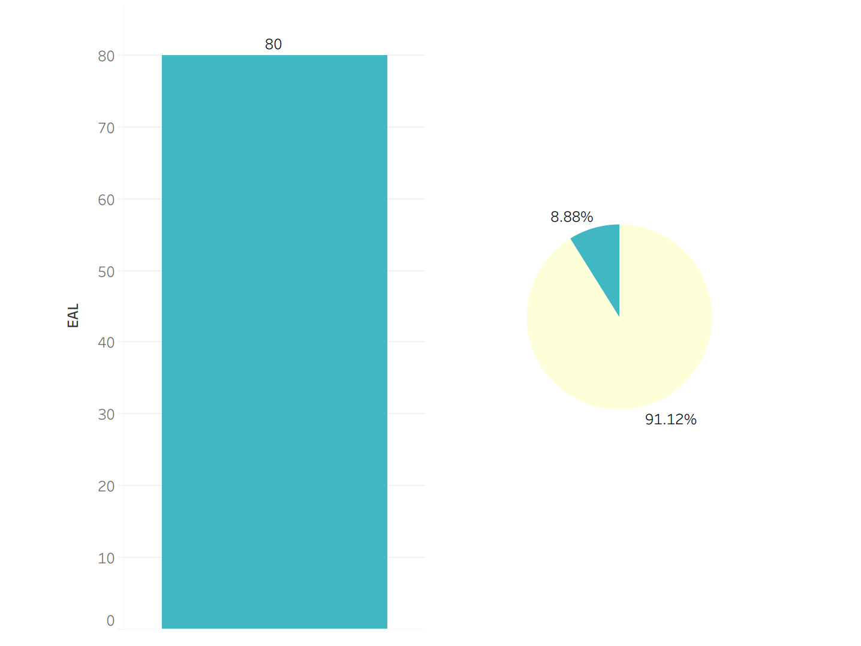
Students with English as a Second Language
Students with English as a second Language
Students without English as a Second Language

Slide 11
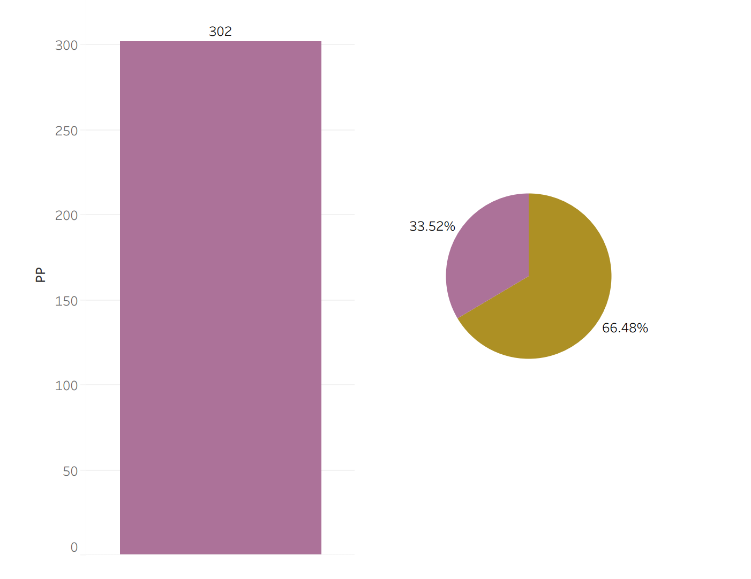
Students that Receive Pupil Premium Funding
Students with Pupil Premium
Students without Pupil Premium

Slide 12
Summary
This dataset showed that there was a significance between the students that received the pupil premium, students with special educational needs and students with English as a second language and their grades.
The dataset also was able to have the student’s grades predicted with 98.9% accuracy.

Slide 13
Conclusion
Overall, this analysis will help teachers and administrators be able to predict student grades and help their potential areas of weaknesses.
It will also allow them to see students strengths and areas that they do not need further learning assistance.
This process and machine learning is a great tool that won’t replace students earning their actual grades. However, it will enhance the viewpoint of teachers and administrators to be able to further assist students.

